Slide 1
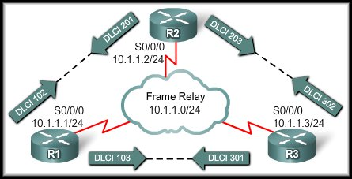
Frame Relay
Advanced Frame Relay Concepts

Slide 2
Advanced Frame Relay Concepts
Paying for Frame Relay:
  Access or port speed:
    The cost of the access line from the DTE to the DCE (customer to service provider).
  Permanent Virtual Circuit (PVC):
    This cost component is based on the PVCs.
  Committed Information Rate (CIR):
    Customers normally choose a CIR lower than the port speed or access rate (U.S.).
    This allows them to take advantage of bursts.
    NOTE: There is no CIR in Canada.

Slide 3
Advanced Frame Relay Concepts
Paying for Frame Relay:
  Oversubscription:
    Service providers sometimes sell more capacity than they have on the assumption that not everyone will demand their entitled capacity all of the time.
    Because of oversubscription, there will be instances when the sum of CIRs from multiple PVCs to a given location is higher than the port or access channel rate.
    This can cause traffic issues, such as congestion and dropped traffic.
    Be aware that this can happen!

Slide 4
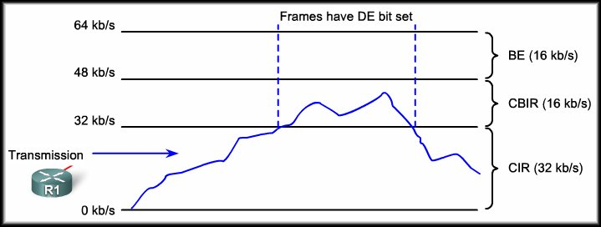
Advanced Frame Relay Concepts
Bursting:
  Because the physical circuits of the Frame Relay network are shared between subscribers, there will often be time where there is excess bandwidth available.
  Frame Relay can allow customers to dynamically access this extra bandwidth and "burst" over their CIR for free.

Slide 5
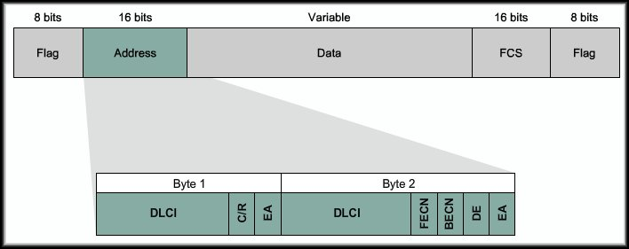
Advanced Frame Relay Concepts
Frame Relay Discard Eligibility Bit:
  The frame header also contains a Discard Eligibility (DE) bit, which identifies less important traffic that can be dropped during periods of congestion.
  DTE devices can set the value of the DE bit to indicate that the frame has lower importance than other frames.
  The DE bit is automatically set during a “burst” situation.

Slide 6
Advanced Frame Relay Concepts
Frame Relay Flow Control:
  Frame Relay flow control is a matter of controlling congestion on the frame relay network.
  There are two bits that are set on the frame header when congestion occurs.
    Forward Explicit Congestion Notification (FECN)
    Backward Explicit Congestion Notification (BECN)

Slide 7
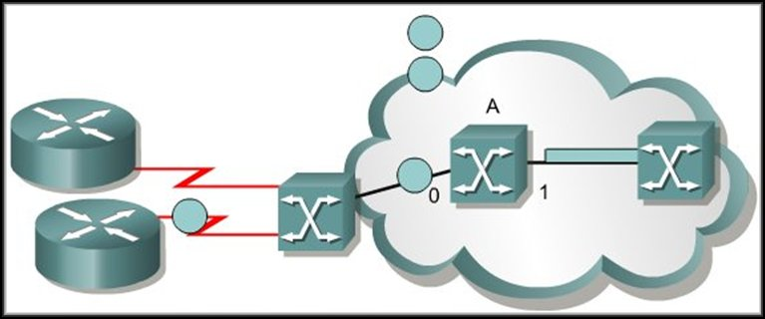
Advanced Frame Relay Concepts
Frame Relay Flow Control:
  While Frame Relay Switch A is placing a large frame on interface 1, other frames for this interface are queued.
Traffic Flow

Slide 8
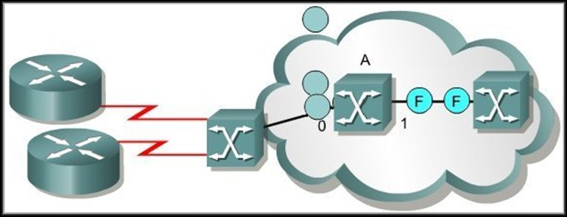
Advanced Frame Relay Concepts
Frame Relay Flow Control:
  When the queue is sent, down stream devices are warned of the queue by setting the FECN bit in the header of the frame that was received on the congested link.
Traffic Flow

Slide 9
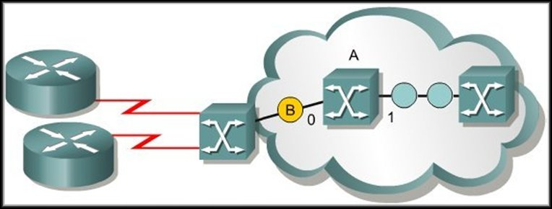
Advanced Frame Relay Concepts
Frame Relay Flow Control:
  Upstream devices are warned of the queue by setting the BECN bit in the header of any frames sent on the congested link.
  Each upstream device receives the BECN frame.
Traffic Flow

Slide 10
Advanced Frame Relay Concepts
Frame Relay Flow Control:
  Even though a device may not have contributed to the congestion, it still receives the BECN frame.
  Each device that provides input to the switch is instructed to reduce the rate at which it is sending packets.
Traffic Flow

Slide 11
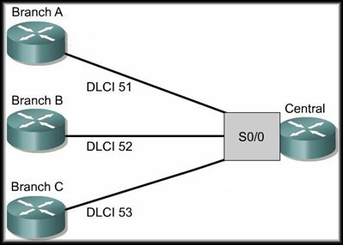
Solving Reachability Issues
Frame Relay is a Non-Broadcast
Multi-Access (NBMA) network.
  In Ethernet, multiple nodes
  can access the network and
  all nodes see all broadcasts
  or multicasts.
However, in a non-broadcast network such as Frame Relay, nodes cannot see broadcasts of other nodes unless they are directly connected by a virtual circuit.
This means that Branch A cannot directly see the broadcasts from Branch B, because they are connected using a hub and spoke topology.

Slide 12
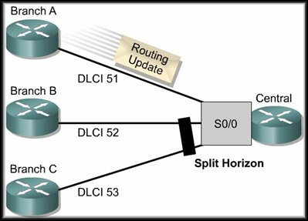
Solving Reachability Issues
Split Horizon
prohibits routing updates received on an interface from exiting that same interface.
Example:
  The Central router learns about Network X from
  Branch A.
  That update is learned via S0/0.
  The Central router must then send its own update
  to Branch B and Branch C.

Slide 13

Solving Reachability Issues
One Solution is to
turn off split horizon
for IP.
Of course, with split horizon disabled, the protection it affords against routing loops is lost.
Split horizon is only an issue with distance vector routing protocols like RIP and EIGRP.
It has no effect on link state routing protocols like OSPF.
no ip split-horizon

Slide 14
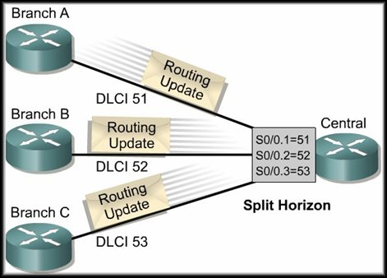
Frame Relay Subinterfaces
A better solution is to use
Subinterfaces.
Subinterfaces are logical
subdivisions of a
physical interface.
In split-horizon routing
environments, routing
updates received on one subinterface can be sent out on another subinterface.
  With this configuration, each PVC can be configured as a point-to-point connection and treated as a separate physical interface – similar to a single leased line.

Slide 15
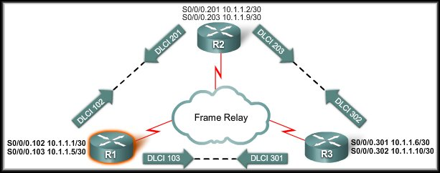
Frame Relay
Configuring Advanced Frame Relay

Slide 16
Configuring Frame Relay Subinterfaces
Configure encapsulation on the interface.
R1(config)#interface serial-number
R1(config-if)#encapsulation frame-relay
R1(config-if)#interface
serial-number.subinterface-number
{multipoint | point-to-point}
R1(config-subif)# frame-relay interface-dlci
dlci-number
Create the sub-interface with the IP Address and any other parameters that apply.
Use this command to map the DLCI to the IP Address – not frame-relay map.

Slide 17
Configuring Frame Relay Subinterfaces
Note that the IP Addressing scheme has changed to provide separate IP subnets for each Frame relay link.
Also note that the DLCI number is used as the sub-interface number.

Slide 18
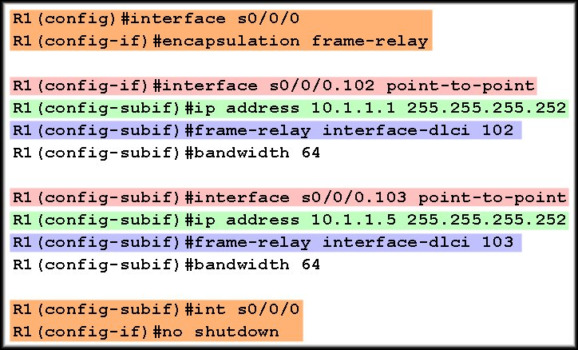
Configuring Frame Relay Subinterfaces

Slide 19
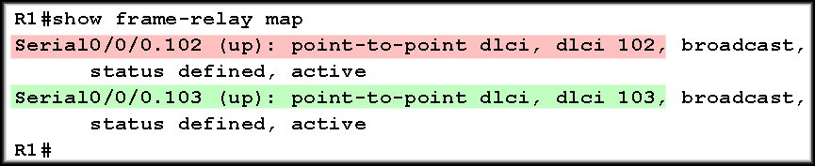
Configuring Frame Relay Subinterfaces

Slide 20
Configuring Frame Relay Subinterfaces
Configure Frame Relay encapsulation on the interface.
Create a sub-interface for each DLCI on the connection.
  Use the DLCI number – helps in troubleshooting
  Configure the IP address.
  Map the DLCI.
Active the entire interface, not each individual sub-interface.
Use the following commands to verify.
  show frame-relay-map
  show frame-relay lmi
  show frame-relay pvc [dlci-number]
  debug frame-relay lmi

